Slide 1
ARDUINO+IOT TECHNOLOGY
name - vachi jain
roll no - 1802071062
branch - digital electronics. 5th SEM
subject - itpr
college - ambedkar institute of technology, shakarpur delhi-91
submitted to - mr. rajat halder

Slide 2


Slide 3
BASIC DIFFERENCE B/W MICROPROCESSOR AND MICROCONTROLLER WHAT IS A MULTIMETER.
MICROPROCESSOR | MICROCONTROLLER
Microprocessor is the heart of Computer system. | Micro Controller is the heart of an embedded system.
It has no RAM, ROM, Input-Output units, timers, and other peripherals on the chip. | It has a CPU along with RAM, ROM, and other peripherals embedded on a single chip.
It works on high speed, and has high efficiency | It works on low speed. , and has low efficiency
MULTIMETER :-
It is an electronic measuring instrument that combines several measurement functions in one unit.
A typical multimeter can measure voltage, current, and resistance.
An Analog multimeter is not so accurate because it has coil and a needle which deflects, and hence doesn't show the value accurate.
In multimeter black probe indicates –ve signal and reb probe indicates +ve signal.
To check wire continuity in multimeter 1 should come and beep sound must be there which ensures the continuity check
And for this dial must be set to the continuity check symbol (diode symbol).

Slide 4
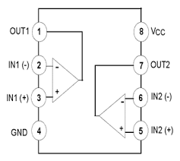
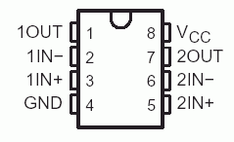
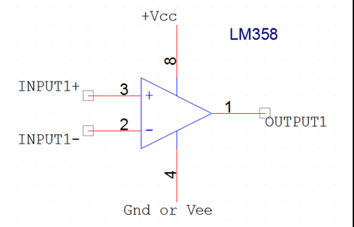
LM358 IC
LM358 IC is a dual op-amp IC.
It has 8 pins which individually performs different tasks.
It usually compares two signals and then generates the output.
Here, +ve means non-inverting input,
–ve means inverting input.
And hence, It consists of two internally frequency compensated, high gain, independent op-amps.
L
M
3
5
8

Slide 5
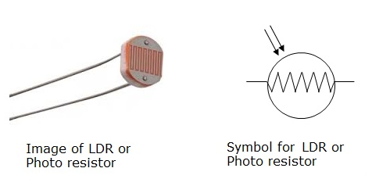
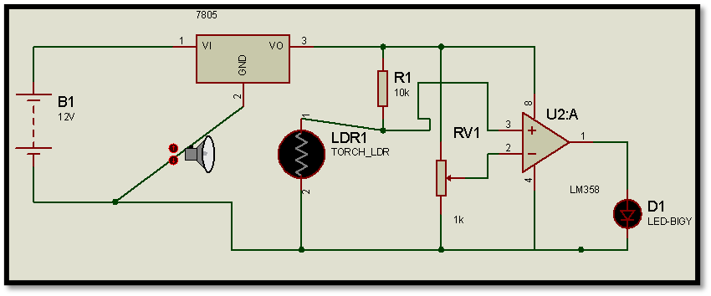
WHAT IS LDR LDR MODULE USING LM358
A Light Dependent Resistor (LDR) is also called a photoresistor.
It is basically a photocell that works on the principle of photoconductivity.
The passive component is basically a resistor, whose resistance value decreases when the intensity of light decreases.
LDR MODULE USING LM358 IC :-
The LDR Sensor Module is used to detect the presence of light / measuring the intensity of light.
To generate output at pin1 of IC the voltage provided at pin 3 must be greater than the voltage provided at pin 2.
And hence resistors and the potentio meter which are to included should be of 10k value.

Slide 6
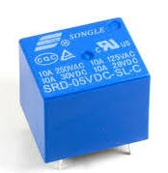
WHAT IS RELAY TYPES OF PIN RELAY
A relay is an electro-mechanical switch.
Relays are used to control high voltage circuits with the help of low voltage signals.
It consists of a relay coil, a metallic strip, spring, common terminal, normally open (NO) and normally close (NC) terminal.
TYPES OF PIN RELAY :-
As soon as the no. of pins increases the no. of COM, NO and NC contacts will also increases.
PINS | NO CONTACT | NC CONTACT | COM CONTACT | RELAY COIL
5 PINS | 1 | 1 | 1 | 2
8 PINS | 2 | 2 | 2 | 2
11 PINS | 3 | 3 | 3 | 2
14 PINS | 4 | 4 | 4 | 2

Slide 7
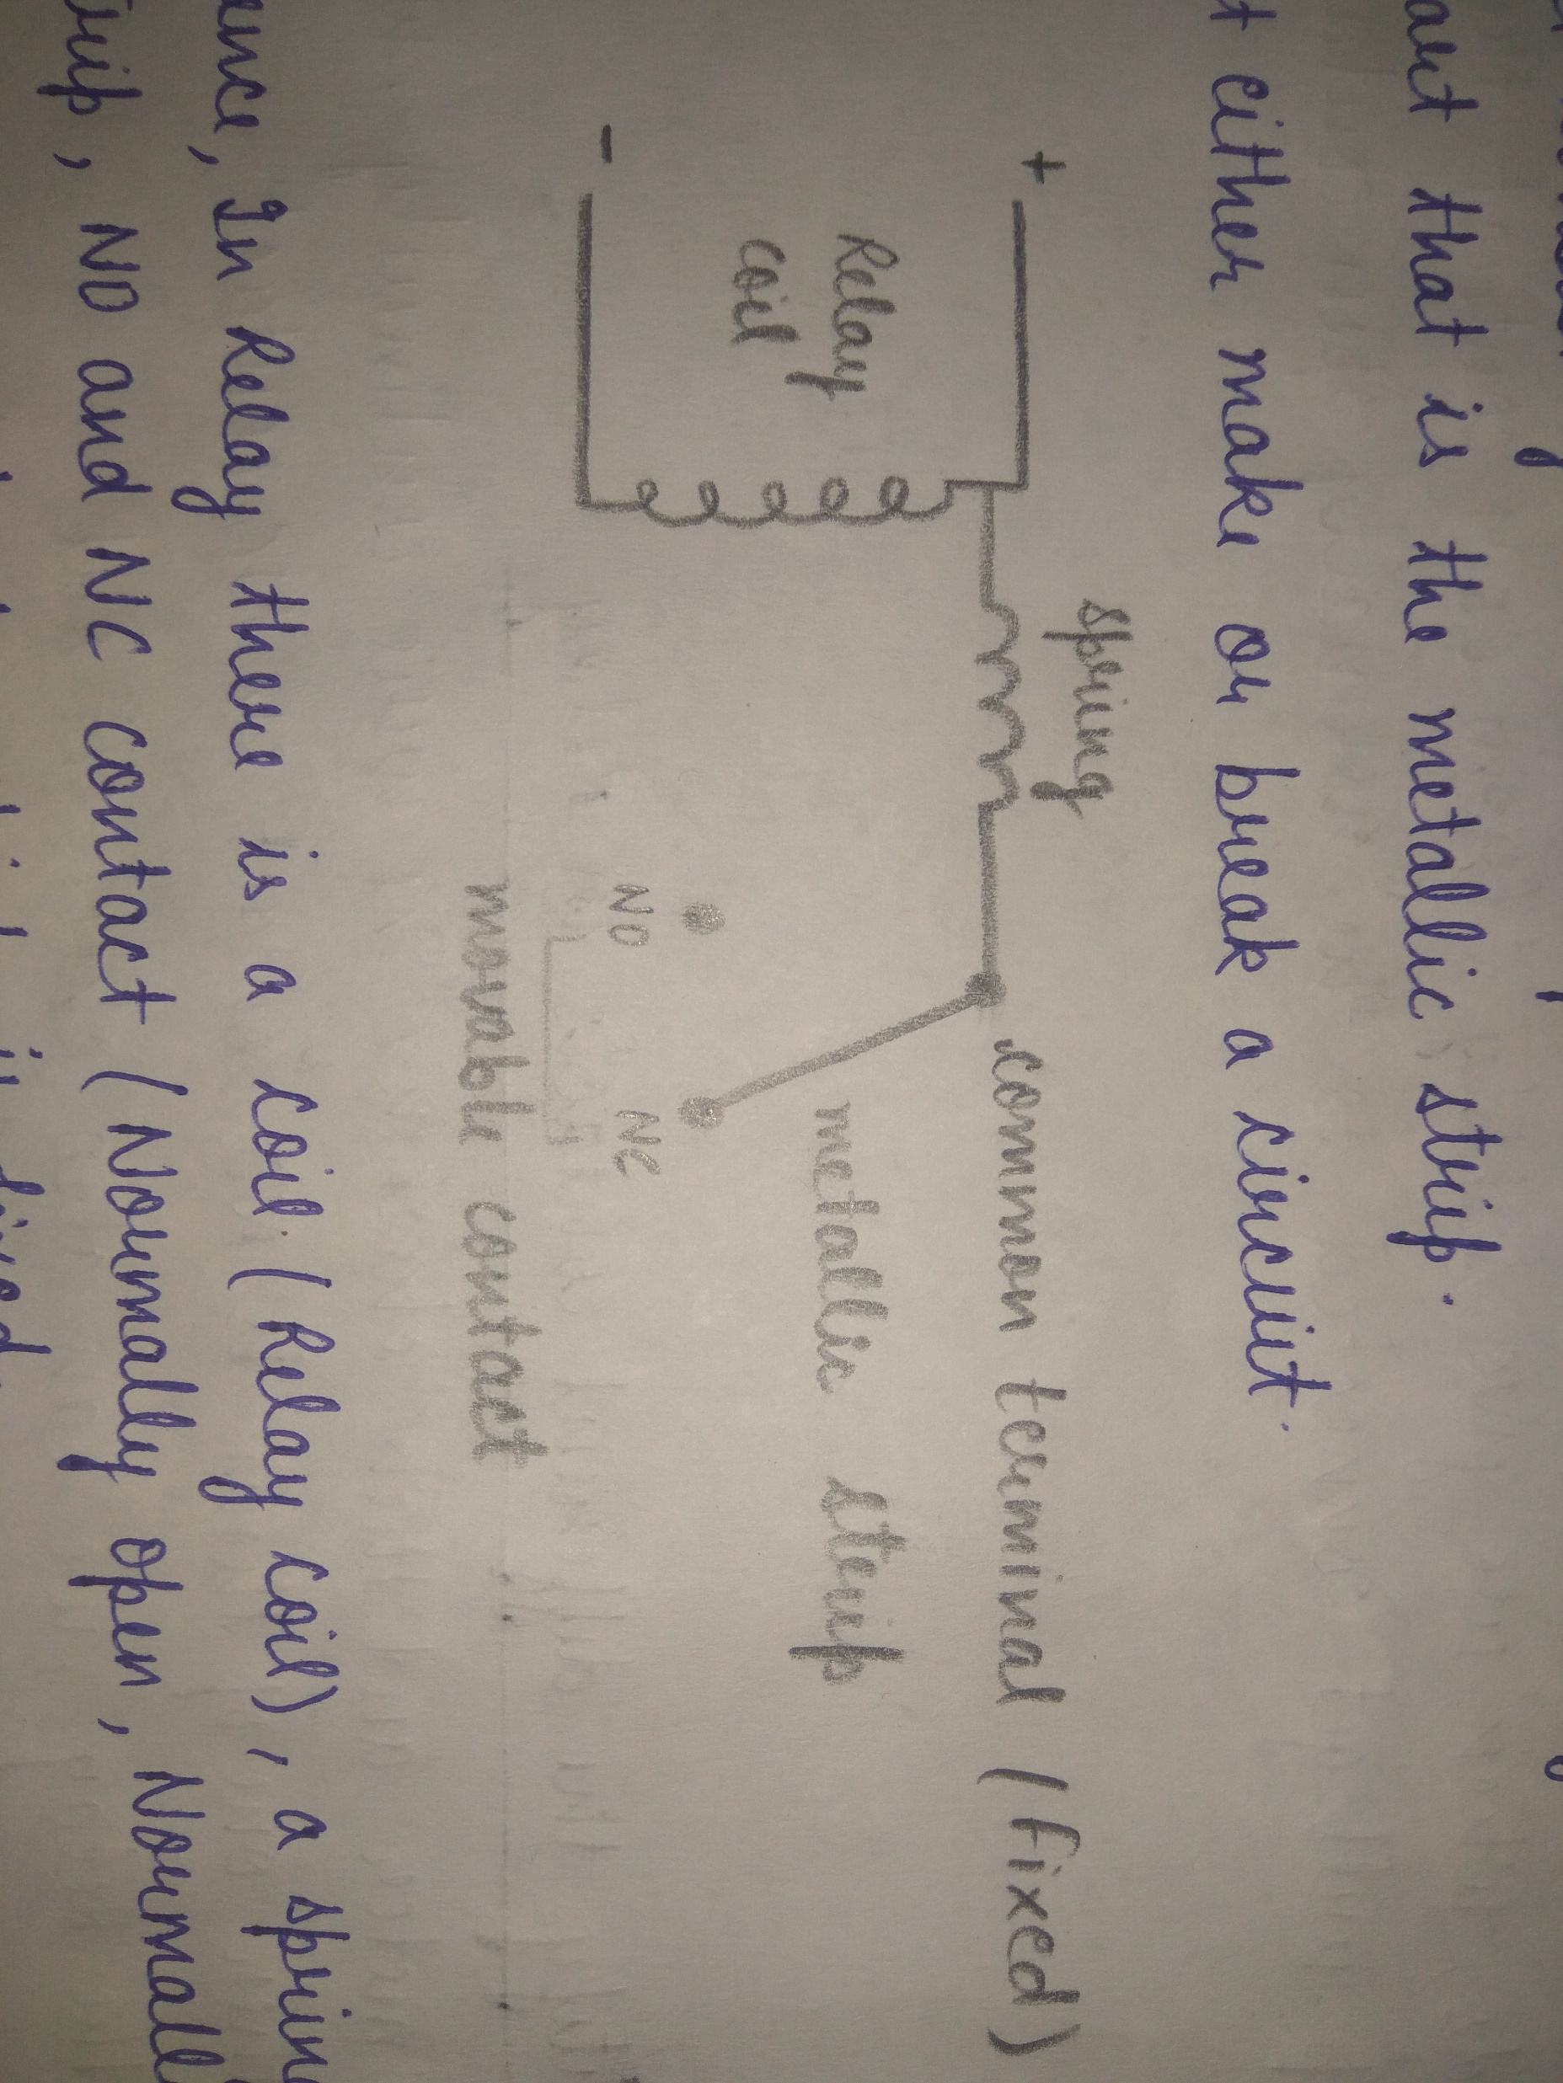
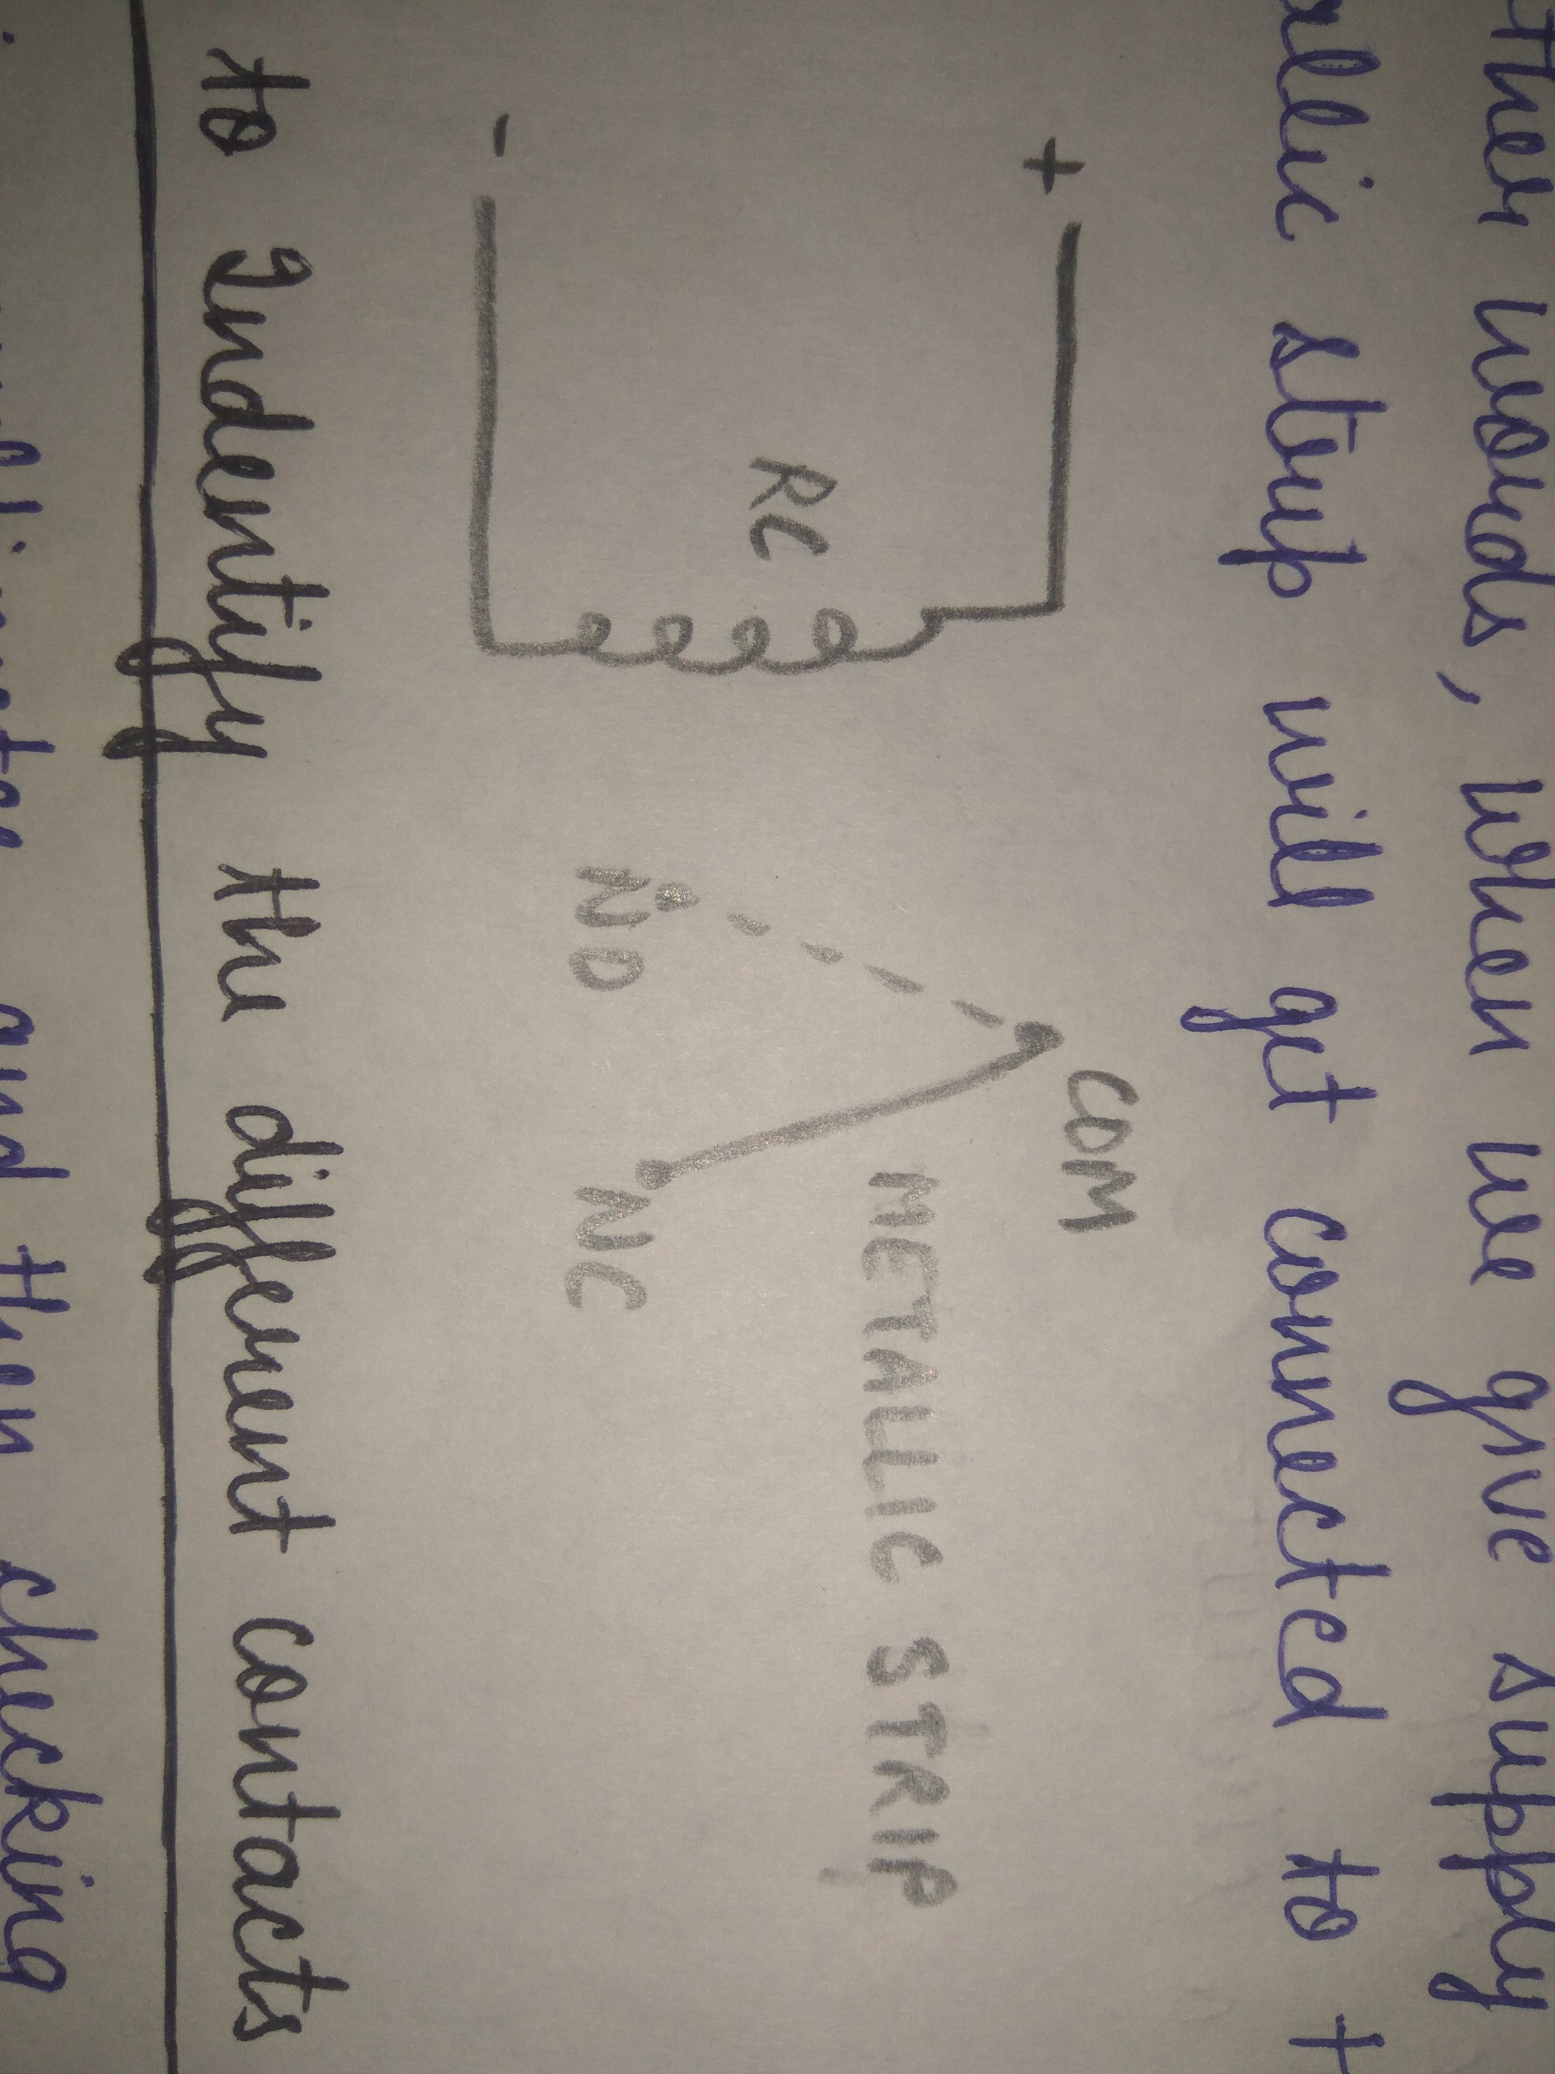
HOW A RELAY GETS ENERGIZED
HOW A RELAY GETS ENERGIZED :-
In relay, coil is the main component, so it must be energized hence it depends on relay coil that whether the relay will break or make the circuit.
Relay comes In different ranges 5V, 6V, 12V, 24V (works on DC) and 220V relay works on AC.
to energized 6V relay the relay coil must have 6A supply. And as soon supply will be given the metallic strip will be connected to NO from the NC contact.
In other words, when we will give supply to COM contact the strip will get connected to normally open contact (NO).
BEFORE GIVING SUPPLY
AFTER GIVING SUPPLY

Slide 8
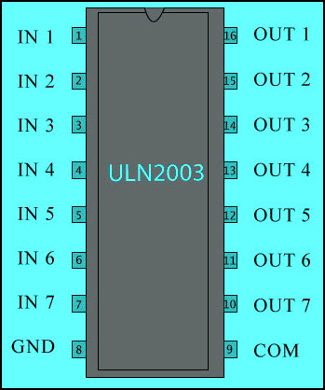
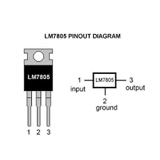
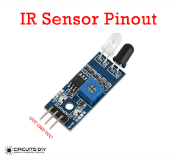
ULN2003A IC, LM7805 IC AND IR SENSOR
ULN2003A IC :- It is a 16 pin IC. Where its pin 16 act as a ground connection.
And hence it is one of the most commonly used Motor driver IC.
By using this IC one can use multiple relay connection connected to it.
LM7805 IC :- A LM7805 IC is a voltage regulator that outputs +5 volts.
And hence A voltage regulator IC maintains the output voltage at a constant value.
In relay circuits usually LM7805 IC is used to give power supply.
IR SENSOR :- An infrared (IR) sensor is an electronic device that measures and detects infrared radiation in its surrounding environment.
It doesn’t detect black color.
works on 3V.

Slide 9
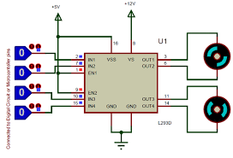
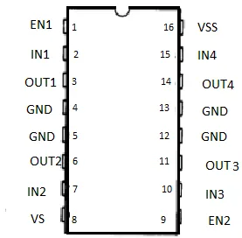
L293D IC (MOTOR DRIVEN IC)
L293D IC is motor driven IC.
It is only be used for low voltage applications.
It has 16 pins, and contains two channels.
Namely channel1 and channel2.
Where enable1 is used to operate channel 1 and
enable 2 is used to operate channel 2.
It can control a set of two DC motors simultaneously in any direction.
It means that you can control two DC motor with a single L293D IC.
EN1 | I/P 1 | I/P 2 | MOTOR
0 (LOW) | 0 | 1 | STOP
0 (LOW) | 1 | 0 | STOP
1 (HIGH) | 0 | 0 | STOP
1 (HIGH) | 1 | 1 | FORWARD DIRECTION
1 (HIGH) | 0 | 1 | REVERSE DIRECTION
1 | 1 | 1 | STOP

Slide 10
ARDUINO PROGRAM FOR MAKING LED BLINK CONSTANTLY
For making the program to make the LED blink constantly we should know the output (0 or 1), time delay if needed.
Hence syntax is very important to pin define in the void setup.
SYNTAX FOR PIN DEFINE
void setup() { pinMode(pinno,OUTPUT);
SYNTAX FOR WRITING ON or OFF (DIGITAL-0,1) (HIGH/LOW)
digitalWrite(pinno,HIGH/LOW);
SYNTAX FOR TIME DELAY
Delay(time in m.s);
PROGRAM FOR CONSTANTLY BLINKING THE LED AFTER 1 SEC.
void setup() { pinMode(10,OUTPUT); } void loop() { digitalWrite(10,HIGH); delay(1000); digitalWrite(10,LOW); delay(1000); }

Slide 11
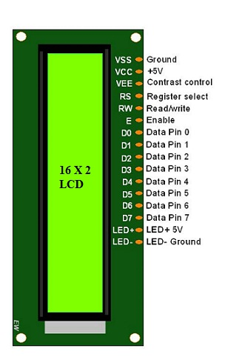
LCD PIN CONFIGURATION BASIC SYNTAX FOR LCD
Instead of using serial monitor, LCD is also make in use.
LCD comes in many variations. And accordingly has different pins.
Important pins to be connected to the microcontroller are – Rs, enable, D4, D5, D6, D7, and RW to be connected to ground always.
For using LCD, header file is important.
#include <LiquidCrystal.h>
PROGRAM OF 16X2 LCD
#include <LiquidCrystal.h> const int rs=7,en=6,d4=5,d5=4,d6=3,d7=2;
FOR CHANGING THE NAME OF LIQUID CRYSTAL TO OTHER NAME
LiquidCrystal lcd(rs,en,d4,d5,d6,d7);
SYNTAX – TO START
lcd.begin(16,2);
SYNTAX – TO PRINT
lcd.print("WELCOME");
SYNTAX – TO SET CURSOR
lcd.setCursor(7,0);
SYNTAX – TO SCROLL THE LCD SCREEN SIDE BY SIDE
Lcd.ScrollDisplayLeft();

Slide 12
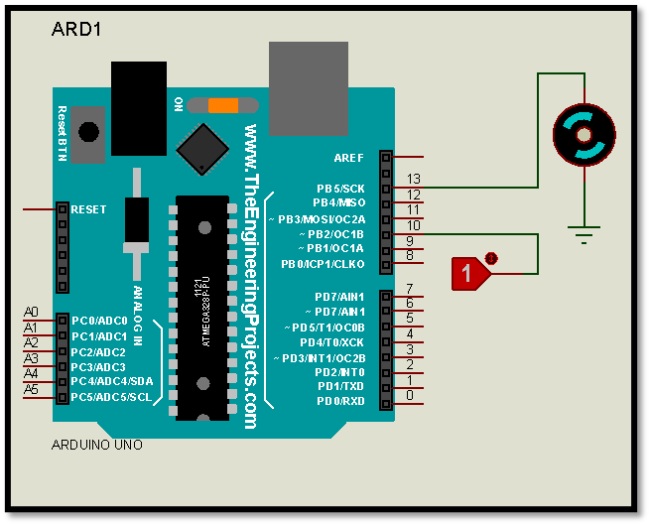
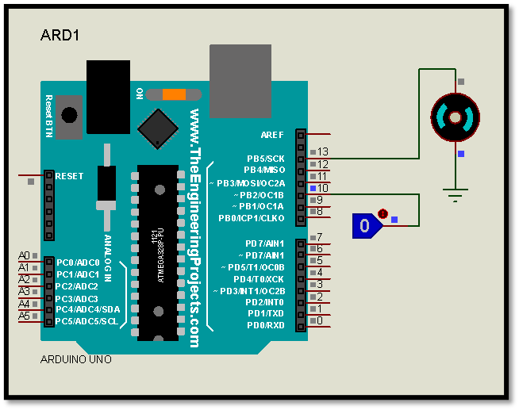
ARDUINO BASED PROJECT – TO MAKE A MOTOR ROTATE USING PUSH BUTTON
OBJECTIVE - TO MAKE A MOTOR ROTATE USING PUSH BUTTON.
COMPONENTS REQUIRED – ARDUINO UNO, LOGIC TOGGLE, DC MOTOR.
PROGRAM TO MAKE A MOTOR ROTATE USING PUSH BUTTON
const int pb=10; const int motor=13; int motor_state=0; void setup() { pinMode (pb,INPUT); pinMode (motor,OUTPUT); } void loop() { motor_state=digitalRead(pb); if (motor_state==HIGH) { digitalWrite(motor,LOW); } else { digitalWrite(motor,HIGH); } }
RESULT –
As soon as program is being uploaded in the Arduino UNO the motor will start rotating when it gets 0 signal.

Slide 13
ARDUINO BASED PROJECT – TO WRITE SOMETHING ON SERIAL MONITOR
OBJECTIVE – TO WRITE SOMETHING ON SERIAL MONITOR.
REQUIRED – ARDUINO IDE SOFTWARE, ARDUINO UNO BOARD, PROGRAM
SYNTAX TO START OR TO BEGIN
Serial.begin(9600);
SYNTAX TO PRINT
Serial.print(“WELCOME");
SYNTAX TO PRINT
Serial.println(“WELCOME");
PROGRAM TO WRITE IN SERIAL MONITOR
void setup() { Serial.begin(9600); } void loop() { Serial.println(“WELCOME"); delay(2000); }
OUTPUT – WELCOME WELCOME WELCOME
PROGRAM TO WRITE IN SERIAL MONITOR
void setup() { Serial.begin(9600); } void loop() { Serial.print(“WELCOME"); delay(2000); }
OUTPUT – WELCOME WELCOME WELCOME

Slide 14
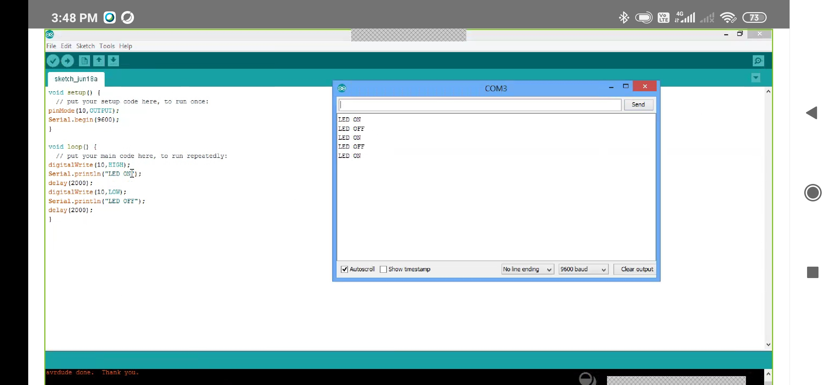
ARDUINO BASED PROJECT – TO HAVE A LED ON OFF MESSAGE ON SERIAL MONITOR
OBJECTIVE – TO WRITE ‘LED ON OFF’ ON SERIAL MONITOR.
REQUIRED – ARDUINO IDE SOFTWARE, ARDUINO UNO BOARD, PROGRAM
THEORY – If high, message will be ON and if low, message will be OFF.
PROGRAM FOR HAVING THE LED ON OFF MESSAGE ON SERIAL MONITOR
void setup() { pinMode(10,OUTPUT); Serial.begin(9600); } void loop() { digitalWrite(10,HIGH); Serial.println("LED ON"); delay(2000); digitalWrite(10,LOW); Serial.println("LED OFF"); delay(2000); }

Slide 15
PROTEUS PROJECT USING ARDUINO – TO MAKE LED BLINK WITH TIME DELAY
OBJECTIVE – TO MAKE LED BLINK WITH 1SEC TIME DELAY.
REQUIRED – ARDUINO IDE SOFTWARE, ARDUINO UNO BOARD, PROGRAM, LED
PROGRAM FOR CONSTANTLY BLINKING THE LED AFTER 1 SEC.
void setup() { pinMode(10,OUTPUT); } void loop() { digitalWrite(10,HIGH); delay(1000); digitalWrite(10,LOW); delay(1000); }

Slide 16
LCD PROJECT – TO PRINT “HELLO CLASS” IN LOOP ON LCD
OBJECTIVE - TO PRINT HELLO CLASS IN LOOP ON LCD.
COMPONENTS REQUIRED – ARDUINO UNO, LCD, PROGRAM
RESULT – hello class will be printed on LCD continuously.
PROGRAM TO PRINT HELLO CLASS IN LOOP ON LCD
#include<LiquidCrystal.h> const int rs=7,en=6,d4=5,d5=4,d6=3,d7=2; LiquidCrystal lcd(rs,en,d4,d5,d6,d7); void setup() { lcd.begin(16,2); } void loop() {lcd.print("hello class "); delay(1000); for(int i=0;i<=14;i++) {lcd.scrollDisplayLeft(); } }

Slide 17
THANK YOU…
BY – VACHI JAIN

